Slide 1


FIT.KOVAI HACKATHON-PRELIMS

Slide 2
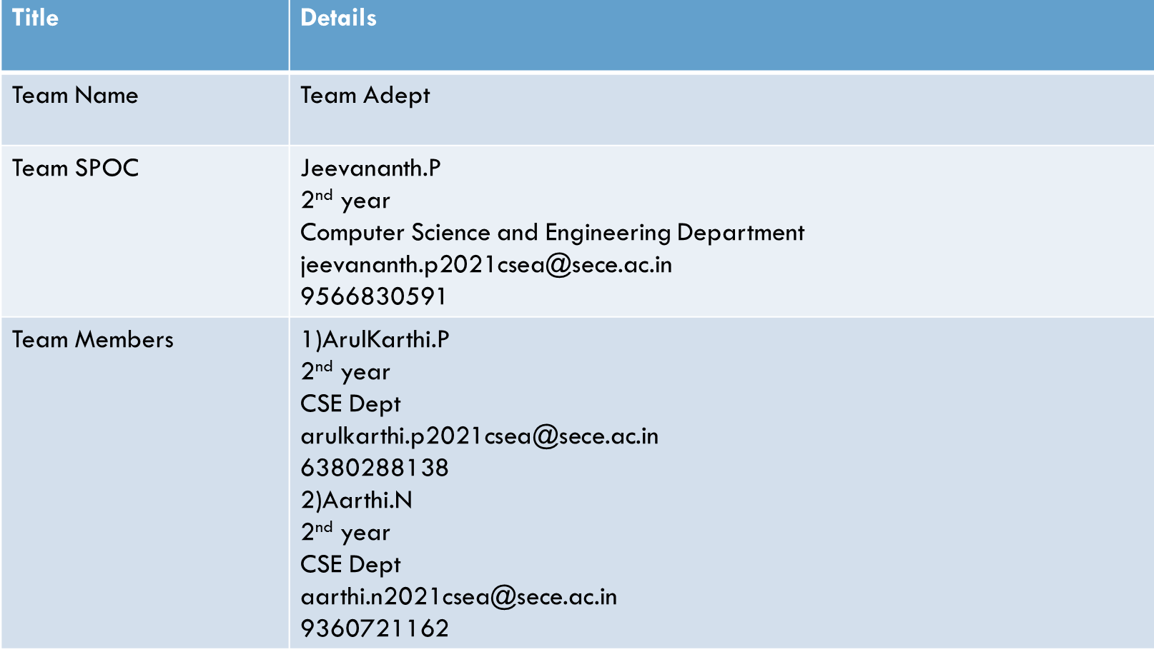
STUDENT TEAM NOMINATION:
3)Jeevavarshini.D
2nd year
CSE Dept
jeevavarshini.d2021csea@sece.ac.in
9361676041

Slide 3

PROBLEM SATEMENT
Music recommendation based on mood detection
Mood/Emotion can be through voice or facial expression or a combination

Slide 4

ABSTRACT:
Python based program to detect human emotions and
recommend songs according to the mood.
This program uses python modules like OpenCV and DeepFace
module which detects emotions,race and gender of people.
Finally, we use WebBrowser module to open the link for suggested songs.

Slide 5

SOLUTION:
There are plenty of applications which will recommend you songs if you search for it.
But now we have to find out the emotion and have to suggest songs based on his/her current mood.
That’s where our solution helps which will track the user’s face on screen and find the mood he is in using Deepface module which will compare each frame with several number of samples and detects the emotion.
Then we use the Webbrowser module to open the link of recommended songs

Slide 6

ASSUMPTIONS:
Let us assume that the user will face the screen and waits for the music to recommend
The Cascade class in the CV2 module tracks the face of the user and the deepface module is used to analyze the face of the user and detects the emotion.

Slide 7
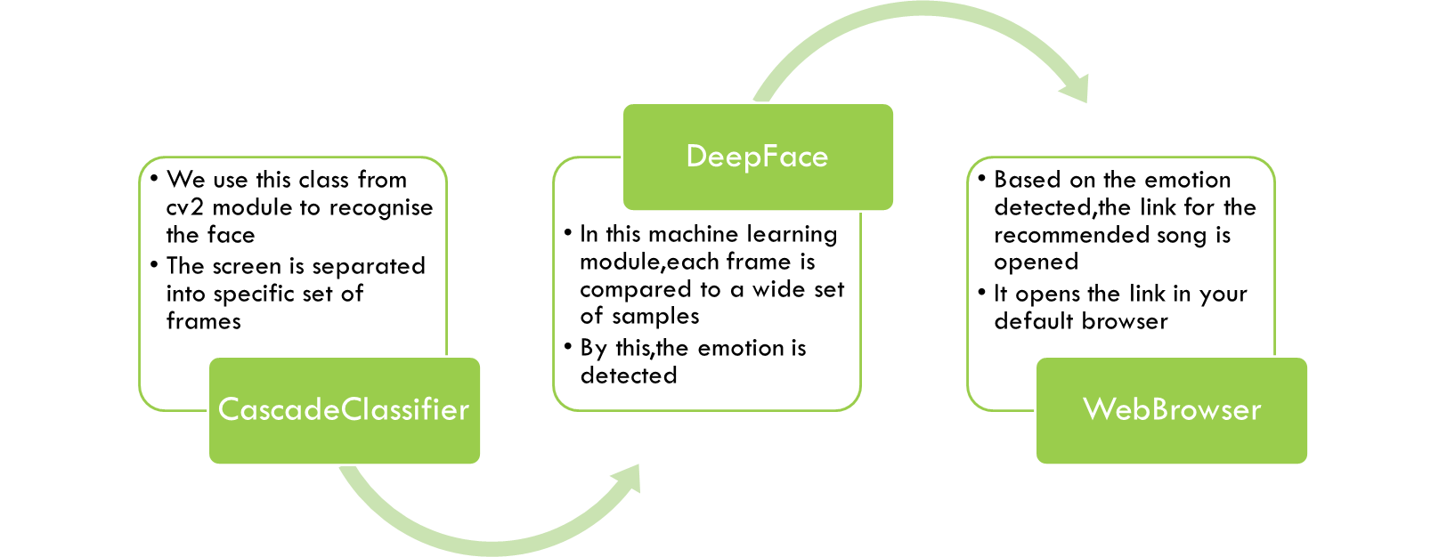
DESIGNS:

Slide 8
TEAM'S COMPETENCE:
Everyone in the team actively participates in the work by taking on different roles and responsibilities.
We encourage each other’s efforts and contributions.
We are efficient in problem solving and constantly listen to each other.
We have the ability to improve our performance through experience and development of individuals and the team.

Slide 9

PRIOR EXPERIENCE:
Has done a Face Recognition project using python for Mini Project.
Has done several other projects for the college.

Slide 10

SUMMARY:
In this deep learning project, we developed a model for real-time human emotion recognition with python,deepface and opencv.
We discussed about Face detection,Website access, and Emtion detection, and finally how to use pre- trained model to detect human emotion in real-time.

Slide 11

Thank you
--Aarthi N
--Arulkarthi P
--Jeevananth P
--Jeevavarshini D

